Slide 1


Integrating Literacy & TEL
Alison Jones GRETB

Slide 2

2015-2019
Literacy and numeracy support programme for apprentices developed in Galway
Materials, resources and assessments produced
All shared with other ETBs
Model of support replicated in other training centres
ALOs appointed to roles in the Training Centres

Slide 3
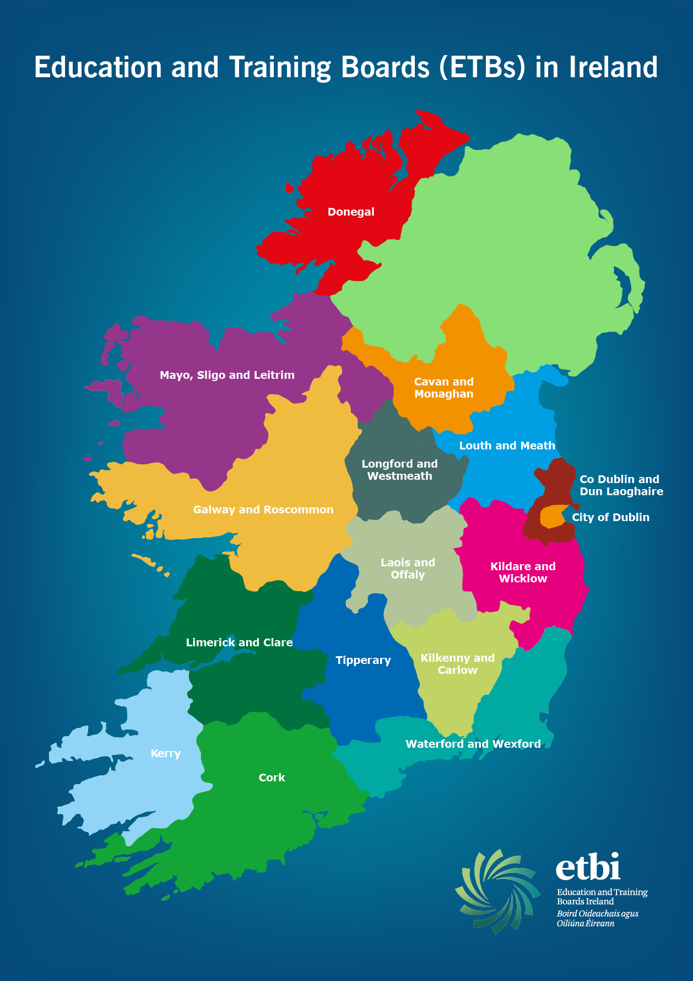
Apprentice Technical Sub-Group
Started informally with LCETB, Donegal and CDETB sharing tips, tricks and materials
Now all 16 ETBs represented
Moodle site with materials repository created
Meet 4 times a year and reports to the NAC
More materials in development
Award winning model (2017)

Slide 4
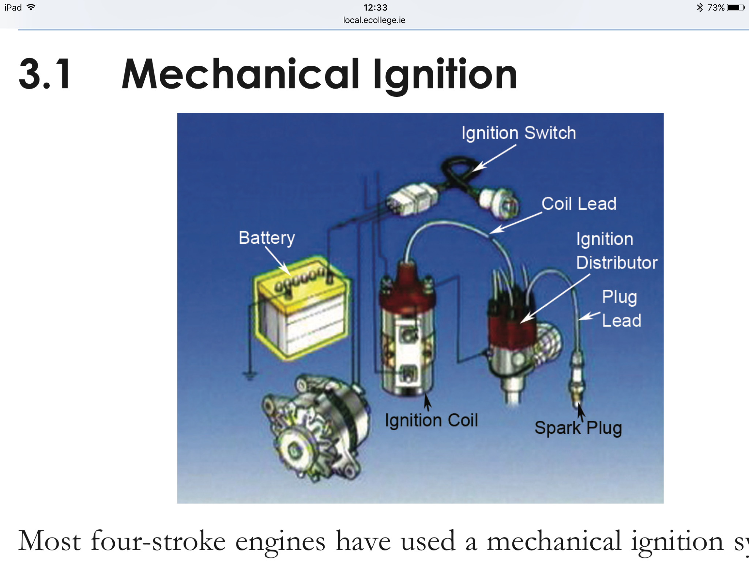
TEL Pioneered in Training Centres
Thinglink
Quizlet
Kahoot
Animated powerpoints
Moodle

Slide 5
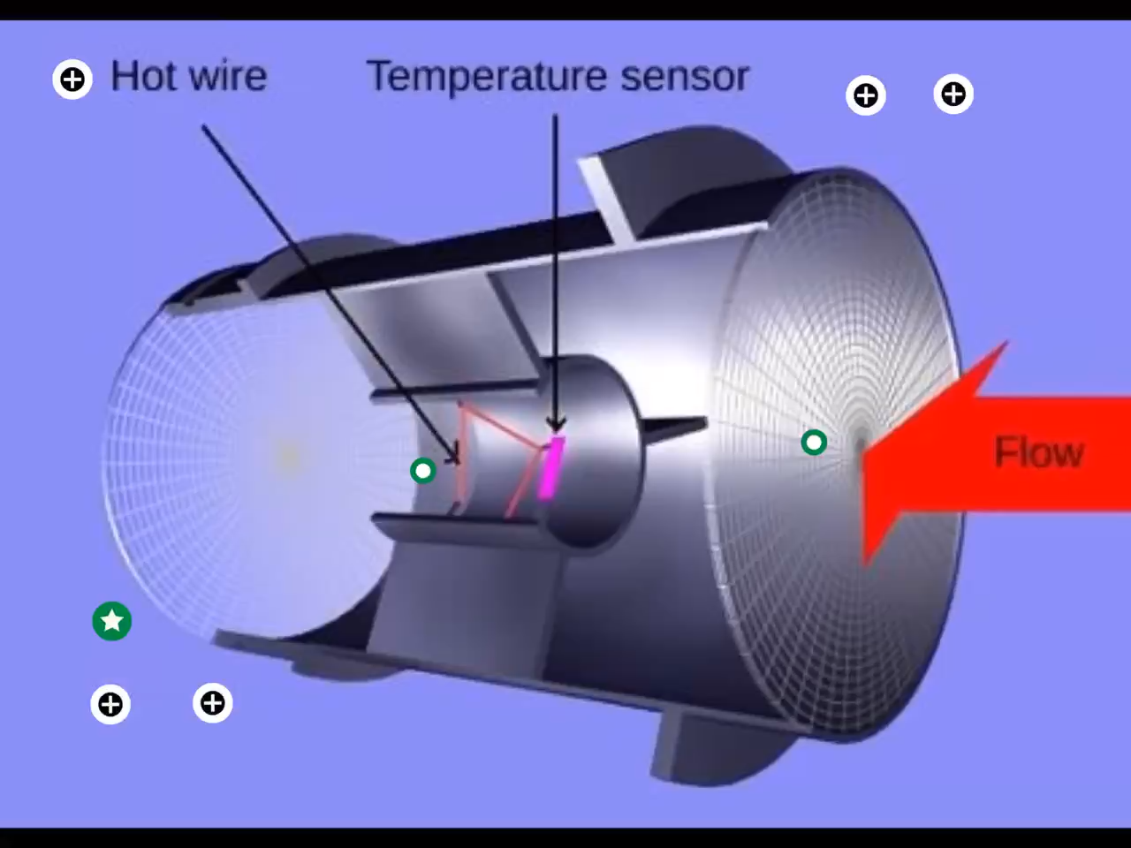
Thinglink and Motor Mechanics

Slide 6
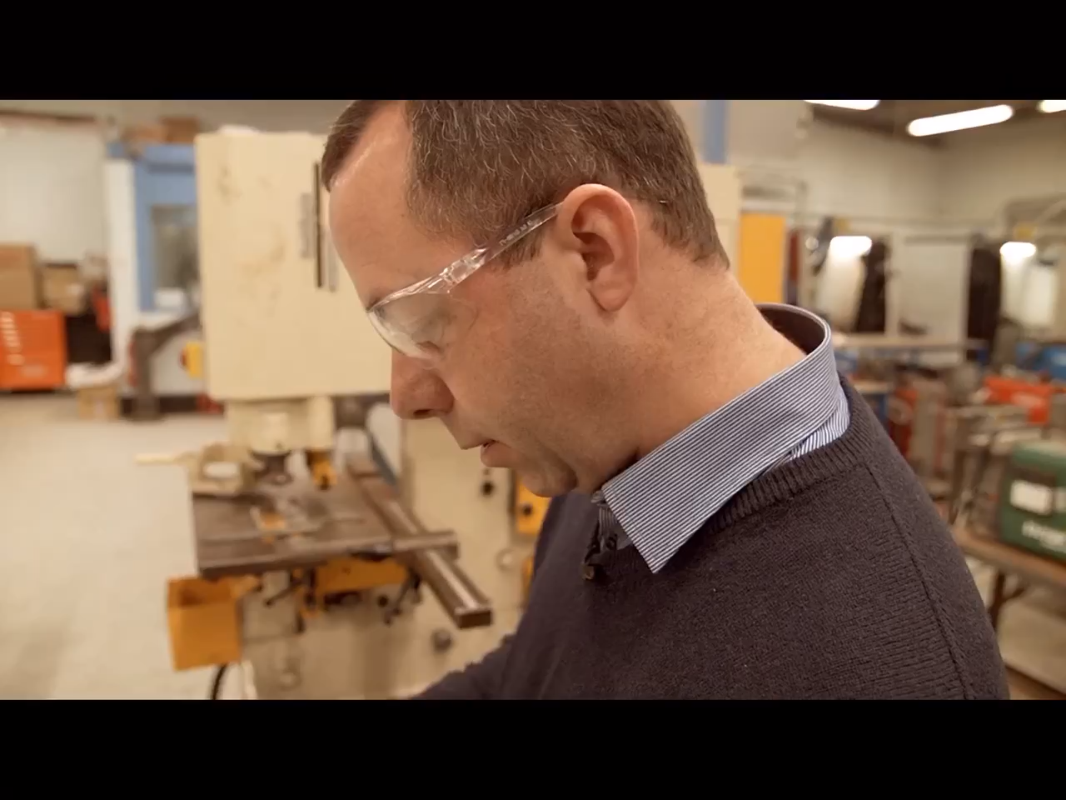
Thinglink and Metal Fabrication

Slide 7
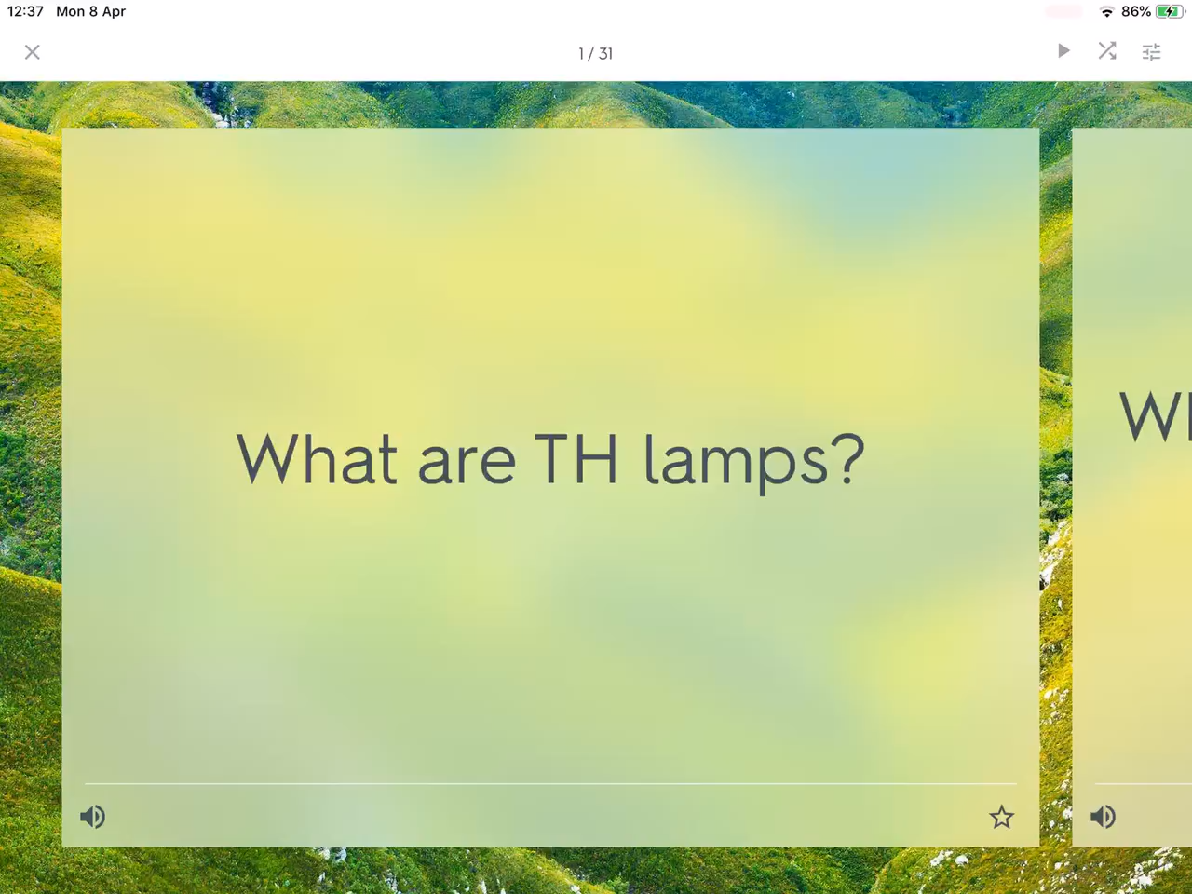
Quizlet for Electricians

Slide 8
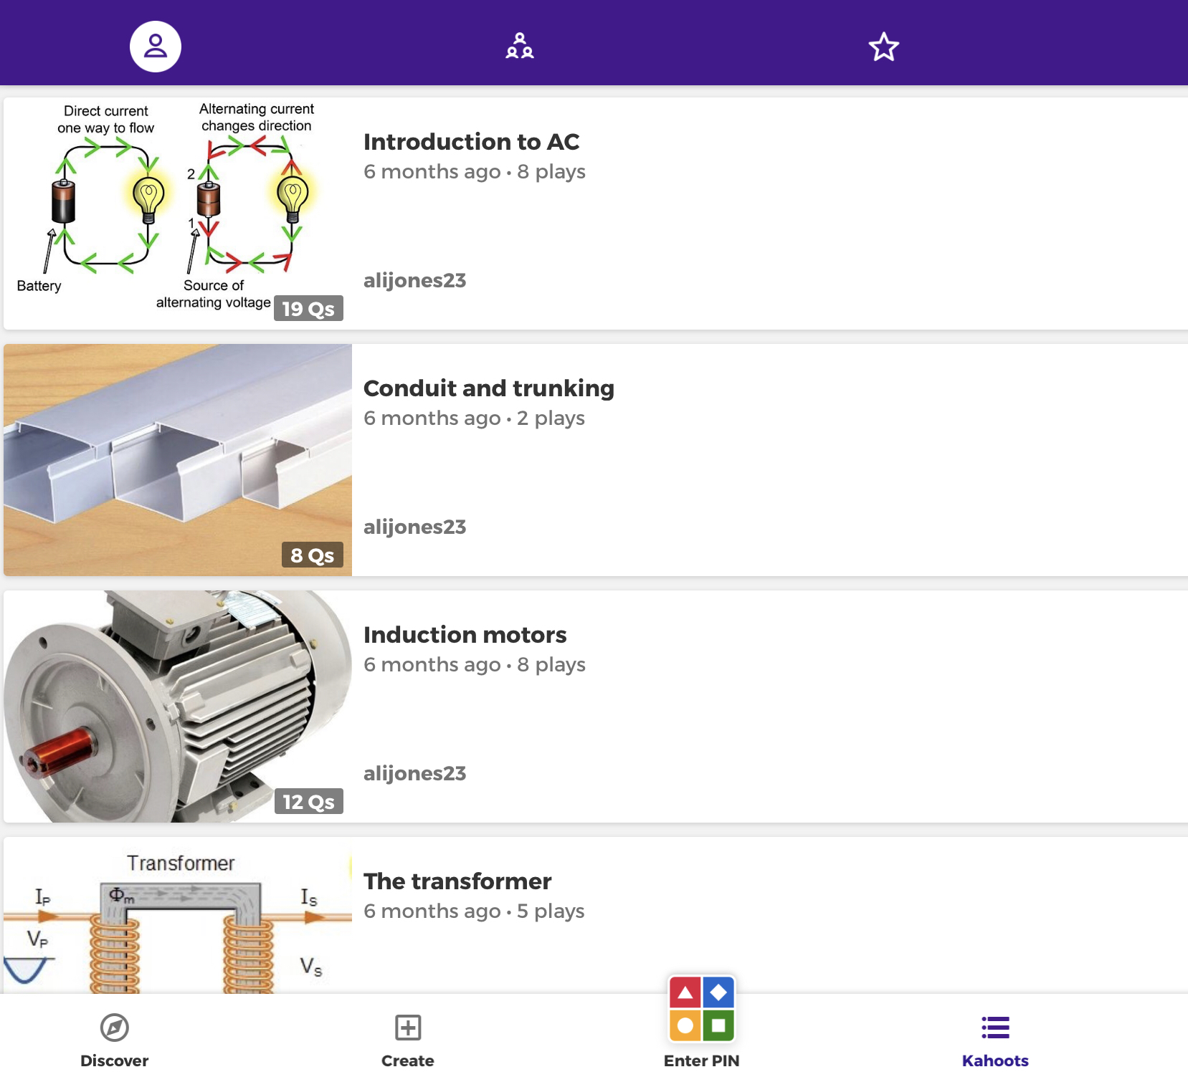
Kahoot for Electricians
Created during the classes with the electricians
All trying to out do each other!

Slide 9
And finally, TEL in Literacy
Syllables app
What is the Story app
Book Creator, original stories available
Thank you and get in touch for any further information
Alison.jones@gretb.ie

